Slide 1
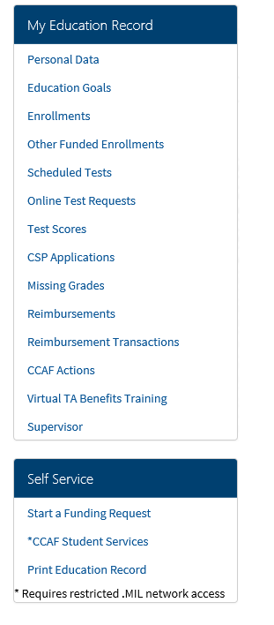
AFVEC
Fed TA Member Application Process
Visit AFVEC
https://afvec.us.af.mil/afvec/Home.aspx
Ensure Personal Data is updated:
Contact Info
Date of Separation (DOS)
Education Goal/Degree Plan
Complete Virtual Benefits Training
Make sure supervisor info up-to-date

Slide 2
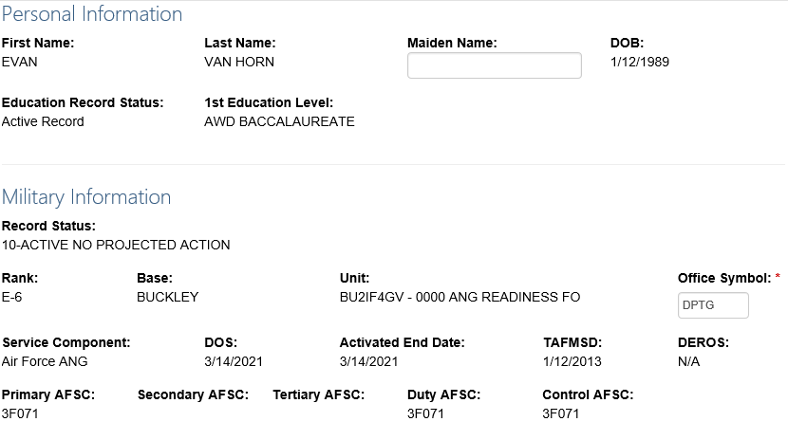
AFVEC
Updating Personal Information
Notes:
Personal Information can be updated in AFAEMS if incorrect
Military Information must be updated by MPS

Slide 3
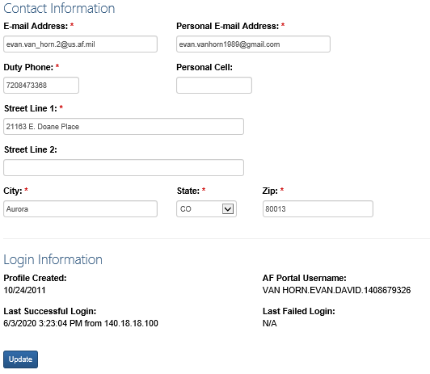
AFVEC
Updating Personal Information
Notes:
Contact info updated by the member crucial for ESO contact

Slide 4
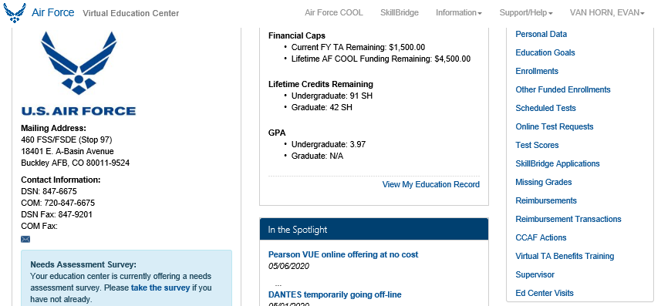
AFVEC
Virtual TA Benefits Training
Notes:
The virtual TA training can be found from the member’s AFVEC homepage

Slide 5
AFVEC
Updating Supervisor Information
Notes:
The virtual TA training can be found from the member’s AFVEC homepage

Slide 6
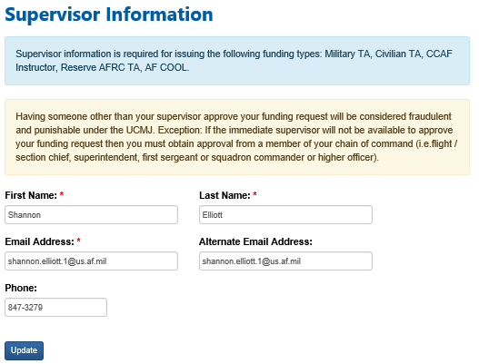
AFVEC
Updating Supervisor Information
Notes:
Having someone other than your supervisor approve your funding request will be considered fraudulent and punishable under the UCMJ. Exception: If the immediate supervisor will not be available to approve your funding request then you must obtain approval from a member of your chain of command (i.e.flight / section chief, superintendent, first sergeant or squadron commander or higher officer).

Slide 7
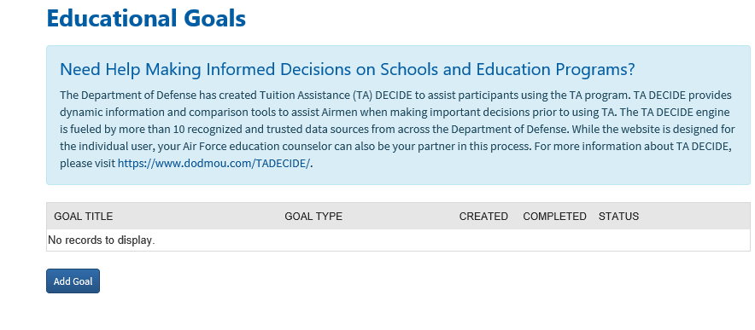
ADDING AN EDUCATION GOAL
Add an Education Goal

Slide 8
ADDING AN EDUCATION GOAL

Slide 9
ADDING AN EDUCATION GOAL
Evaluated Degree Plan

Slide 10
ADDING AN EDUCATION GOAL
Degree plans must be an officially evaluated plan completed by the degree
granting institution and include ALL transfer credit accepted toward degree completion. Transfer work includes but is not limited to academic tests, Community College of the Air Force credit, other Air Force training, and courses taken at other academic institutions. The e-Degree must include ALL courses required for completion of the degree and include the original plan supplied by the institution to the Airman for a single degree.

